Slide 1

Predicting Gas Station Prevelance

Slide 2
Introduction Background
Gas stations are throughout any major city
Often there are a high number of them very close to one another
This could be detrimental to cities over time as they take up space for small business and cause pollution
Goal is to predict how many gas stations surround any given gas station and to build a model
This model can be used in decision making when a new site is being considered
Ottawa is being used as the city to build the predictive model

Slide 3
Datasets Used
Foursquare Places API
Used for finding gas stations and counting the surround 2Km preveleance
Also used for counting the number of venues within each category
Population aquired from Statistics Canada (https://www12.statcan.gc.ca/census-recensement/2016/dp-pd/hlt-fst/pd-pl/Table.cfm?Lang=Eng&T=1201&S=22&O=A)
Ottawa FSAs (https://en.wikipedia.org/wiki/List_of_postal_codes_of_Canada:_K)
Free map tool FSA Finder (https://www.freemaptools.com/find-canada-postcodes-inside-radius.htm))

Slide 4
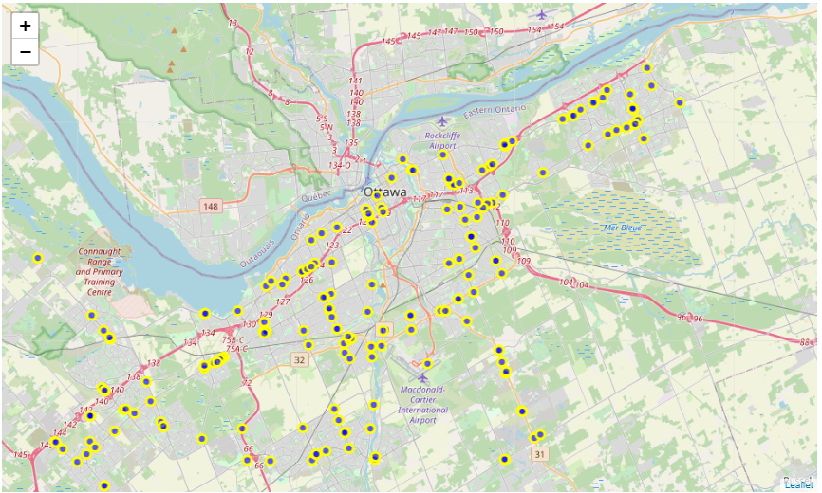
Gas Stations in Ottawa

Slide 5
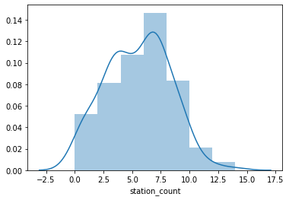
Gas Station Count Distribution
Hypothesized to follow a Poisson Distribution

Slide 6
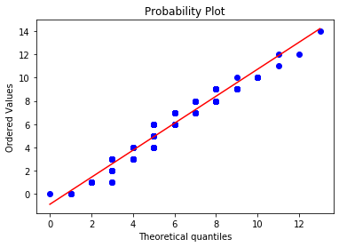
Poisson QQ-Plot
p value of 4.19e-9

Slide 7
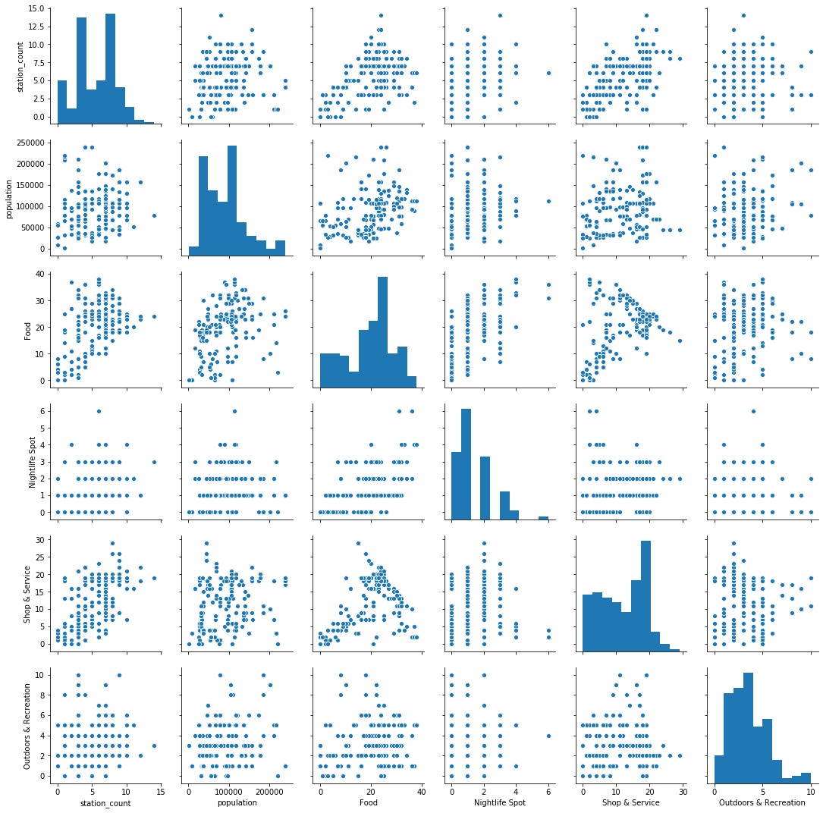
Pair Plot of Features

Slide 8
Model Development and Results
Models | Train CV Results | Test Results
Linear OLS | 2.1725 | 2.083854
Linear Ridge | 2.1729 | 2.075226
Random Forest | 2.145 | 1.874256
Poisson | 2.1744 | 2.154290

Slide 9
Conclusions
Gas station prevalence was statistically shown to follow a Poisson distribution
Model can be used to asses future considerations for gas station development plans.
Due to the ~2 gas station error, if the addition exceeds the models prediction by more than 2 then it definitely should not be build.

